Slide 1
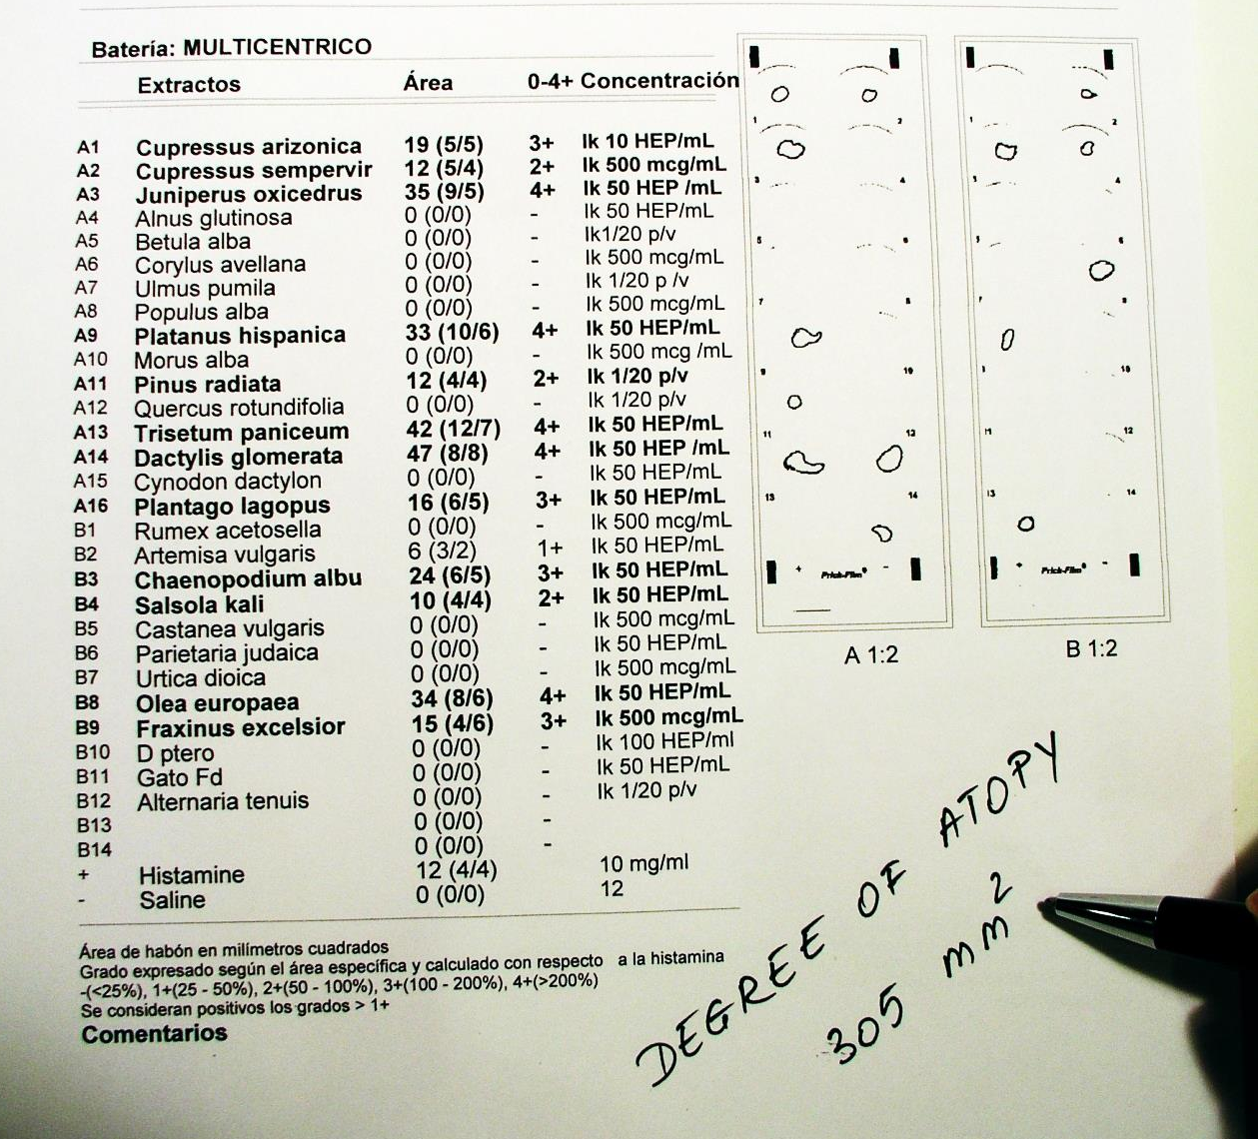
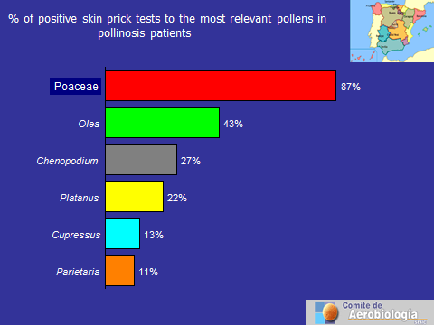
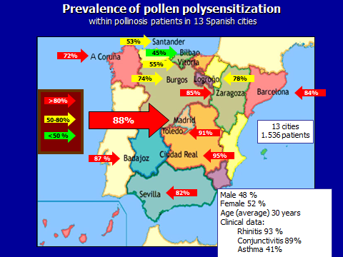
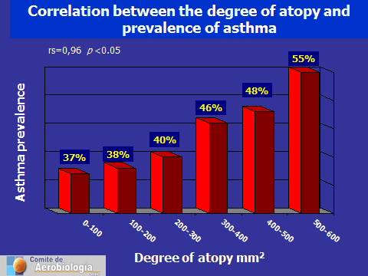
Close correlation between the intensity of a positive skin prick test and the prevalence of asthma in pollinosis patients in Spain.
Javier Subiza, MD†, Enrique Fernández-Caldas PhD††; Jesús Pola, MD*; Ángel Moral, MD‡; and Francisco Feo, MD₫
† Subiza Asthma and Allergy Centre, MADRID; †† Immunotek laboratories, Madrid; * Allergy Unit, Sagasta Policlinic, Zaragoza;
‡Allergy Unit, Virgen del Valle Hospital, Toledo; ₫Allergy Unit, General Hospital, Ciudad Real, Spain
BACKGROUND & OBJECTIVES
Some, but not all, pollen allergic patients with rhinoconjunctivitis suffer asthma. Several hypotheses and/or mechanisms have been proposed. One of the more plausible explanations is the systemic propagation of inflammatory mediators from the nose to the lower airways (1). Considering this possibility, patients with severe allergic rhinitis would be more likely, or at risk, to suffer asthma. The aim of this study is to investigate whether, or not, there is a correlation between the intensity of positive skin prick tests (SPT) to pollens and the prevalence of asthma in pollen allergic patients from different Spanish cities.
MATERIAL & METHODS
Thirteen allergy clinics from 13 different Spanish cities participated in this study.
Patients were selected on the basis of a history of seasonal, or perennial, rhinitis and/or asthma. Patient evaluation was performed by a trained physician and included case history, clinical examination and SPT. From this group, we selected the patients with positive SPT to pollens and with seasonal clinical symptoms.
A total of 1,536 patients were selected (48% male and 52% female), all born and still living in, or around, each city studied. The mean age was 32 years (range 8 to 81 years).
All patients were skin tested with a standardized, commercially available battery of aeroallergens at 50 HEP/mL (Inmunotek Lab, Madrid, Spain). The pollens included 25 species which were considered to be the most representative in the atmosphere of these 13 geographical areas. The selection was based on pollen counts (pollen types that accounted for at least 3% of the yearly total pollen count) and studies of the local vegetation. In addition, D. pteronyssinus, cat dander and Alternaria alternata were also tested.
Steel lancets (Allergy Pricker; DHS) were used (one lancet per antigen to avoid cross-contamination). Histamine chlorhydrate at 10 mg/ml and 50% glycerol-saline were used as positive and negative controls, respectively. All skin-test sites were evaluated after 20 minutes.
The area of each wheal was measured by plannimetry using the Prick-Film system and the appropriate software (Inmunotek, Madrid, Spain). Sin prick test results were expressed in mm². A positive reaction was defined as a wheal of at least half the size of the histamine wheal in the absence of a positive reaction in the negative control.
Additionally, we analyzed the “degree of atopy” for each patient by adding up the wheal areas of all positive allergens tested (Fig. 1). (Degree of atopy: sum of all the positive wheals) (See figure 1).
A Spearman rank correlation coefficient was used to correlate the degree of atopy with the prevalence of asthma.
RESULTS
We diagnosed a 93%prevalence of rhinitis of, 89% of conjunctivitis and 41% of asthma.
The prevalence of sensitization was as follows: grasses 87%, Olea 43%, Chenopodium 27%, Platanus 22%, Cupressus 13% and Parietaria 11% (Fig. 2).
The high prevalence of pollen polysensitization was surprising (75%) (Fig. 3).
We divided our patients into 6 groups, according to their degree of atopy using the following ranges: 0–99 mm2; 100–199 mm2; 200–299 mm2; 300–399 mm2; 400–499 mm2 and 500–599 mm2. The prevalence of asthma within these ranges was: 37%; 38%; 40%; 46%, 48% and 55%, respectively (Spearman rank correlation coefficient rs = 0.96 p < 0.05) (Fig. 4).
Fig. 2: Example on how the degree of atopy was calculated. In this case the sum of the positive wheals accounts for 305 mm²
Fig. 2: Prevalence of positive skin prick tests to the most relevant pollens within the 1.536 pollinosis patients from 13 different cities in Spain.
Fig. 3: Prevalence of polysensitization among pollinosis patients in Spain. Practically in all cities, the prevalence of polysensitization was higher than 50 %. The degree of polysensitization was higher in the center and south than in the north of Spain.
Fig. 4: Prevalence of asthma in patients grouped according to their degree of atopy. Spearman rank correlation coefficient rs = 0.96 p < 0.05) (
CONCLUSIONS
AKNOWLEDGEMENTS
There is a high degree of polysensitization in Spanish patients with allergic rhinoconjunctivitis and allergic to pollens in Spain.
Polysensitization seems to be more prevalent in pollen allergic patients with asthma.
The prevalence of asthma within the pollinosis population in Spain, is very closely related with a greater degree of atopy.
The degree of atopy can be used to detect patients with allergic rhinitis who are more prone to develop asthma.
This study confirms previous observations that polysensitization may be a risk factor for developing asthma
Badajoz: Drs J.M. García Menaya, I. González Galán and C. Cordobés.
Barcelona: Drs J. Belmonte, J.M. Roure, A. Cadahia and J.L. Eseverri.
Bilbao: Drs I. Antepara, Y. Alvarez and J. San Atilano
Burgos: Drs P. Carretero, S. Porres and S. Juste Picón
Ciudad Real: Drs F. Feo Brito, P. Mur Gimeno and E. Gómez Torrijo
Corunna: Drs M. Ferreiro Arias and M.A. Rico Díaz
Logroño: Dr T. Lobera
Madrid: Drs J. Subiza, M. Masiello, M.J. Narganes and C. Barjau
Santander: Drs V. de Benito and J. Soto
Seville: Drs A. Chaparro, J. Delgado and J. Conde
Toledo: Drs A. Moral and C. Senent
Vitoria: Drs G. Gastaminza, Y. Álvarez, J. San Atilano and D. Muñoz Lejarazu
Zaragoza: Drs J. Pola, C. Zapata and E. Sanz
REFERENCE
1. Braunstahl GJ, Overbeek SE, Kleinjan A, Prins JB, Hoogsteden HC, Fokkens WJ: Nasal allergen provocation induces adhesion molecule expression and tissue eosinophilia in upper and lower airways. J Allergy Clin Immunol 2001, 107:469-476

